Slide 1
Consumer Analysis

Slide 2
INFORMATION VISUALIZATION PROJECT
TEAM MEMBERS
ARYA DADHICH | 19MIA1025
UDBHAV NEMMANI | 19MIA1041
HARSHINI K AIYYER | 19MIA1050
GAURAV TRIVEDI | 19MIA1077

Slide 3
DATABASE DESCRIPTION
The dataset is loosely based on the shopping details for customers of few cities.
The values vary profoundly which makes it simple & basic to re-produce any kind of visualization based on it.
This dataset has 2 files - the first file has the entire data for customer shopping while the other file has the indexed data based on a matrix according to the cities. (Customer_shopping_data)

Slide 4
DATABASE DESCRIPTION
The dataset (Customer_shopping_data) consists of attributes as follows:
Customer ID
Customer gender
Age
City
Annual Income
Credit score
Spending score

Slide 5
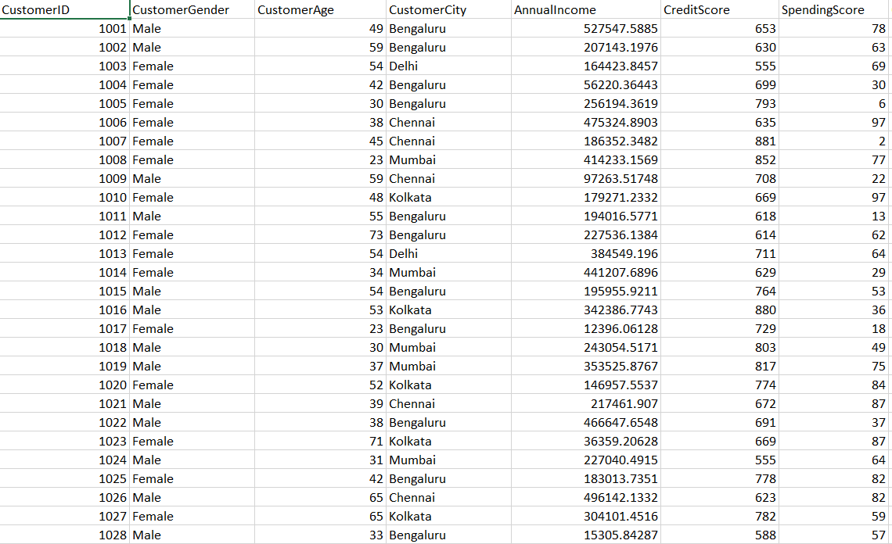
DATABASE DESCRIPTION

Slide 6
Project analysis slide 2
PROBLEM DESCRIPTION
In this project, we will be analysing customers of a shopping mart based on different attributes like Gender, Age, Income etc. using different visualization techniques.
We will conclude this project with detailed description of type of customer which are most profitable to the brand.
Which section of customer should be approached based on age, gender, annual income, city, etc.

Slide 7
Project analysis slide 3
OBJECTIVES
ANNUAL INCOME
ANALYSIS
AGE
ANALYSIS
GENDER ANALYSIS
CITY
ANALYSIS
Analysing the annual income of various households, to demand and needs by potting k- means clustering graph and using different statistical tools.
Analyzing the age group to understand the customer behavior, as it is an important demographic factor affecting consumer behavior by plotting bar graphs, k –means clustering and using various statistical tools
Understanding the role of gender in sales and marketing for a brand using pie chart and histogram.
Analyzing different customers based on city they live in using histogram and bar plots.

Slide 8
Project analysis slide 2
Big Picture
&
Motivation
With increasing customer demands and Globalisation, it is important to understand the behaviour of customer for any brand.
In the situations like Covid-19 PANDEMIC, it is important for a brand to focus on most profitable customers and aim to increase sales in a particular region.
After this pandemic is over, brands will need data inform of Visualization to take critical decisions and to form a proper marketing plan for growth and survival of the brand.
Industrial experience for team members, considering current situations.

Slide 9
Project analysis slide 2
ACTION PLAN
We will be using Python 3/ MATLAB/ Tableau to understand and analyse different aspects of the project.
We will communicate and work on same data using GitHub.
We will divide work in modules to ease out working and to reduce communication.
Basically, we will have 6 tools of analysis:
Histogram
Bar plots
Statistical tools (Mean, Median, Mode, etc.)
K- means clustering
Linear regression
Pie charts

Slide 10
Thank You

